Slide 1


Charlotte-Mecklenburg EQUITY INDICATORS REPORT

Slide 2
CHARLOTTE-MECKLENBURG EQUITY INDICATORS REPORT
Prepared by:
Kailas Venkitasubramanian, PhD
Providence Adu
Pratik Chaudhari
Reviewed by:
8/4/2021
3

Slide 3
TABLE OF CONTENTS
5
10
24
41
Introduction
Indicators 1
Indicators 2
Conclusion
4

Slide 4
Equity Indicators – Introduction

Slide 5
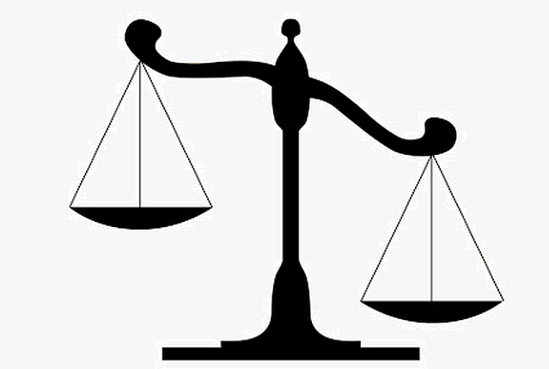
Introduction
Data & Methodology
Equity as a central feature of local and regional policy
Data Informed Decision Making
Eguity Indicator Tool

Slide 6
Data & Methodology

Slide 7
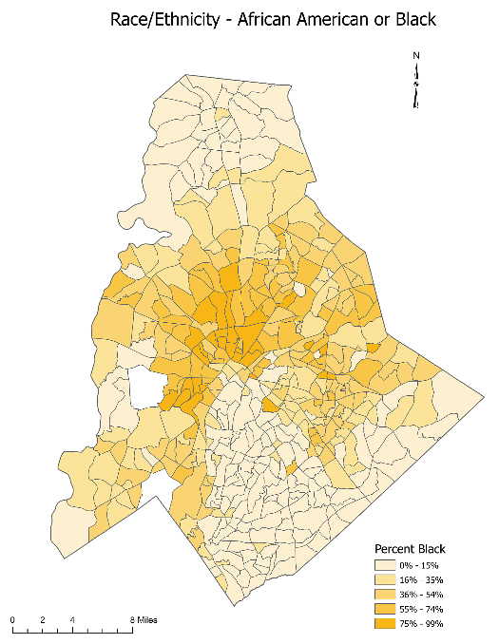
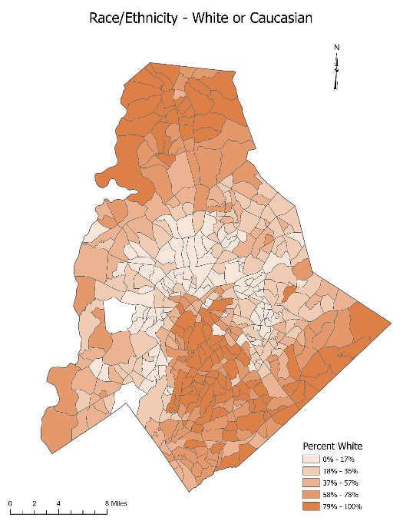
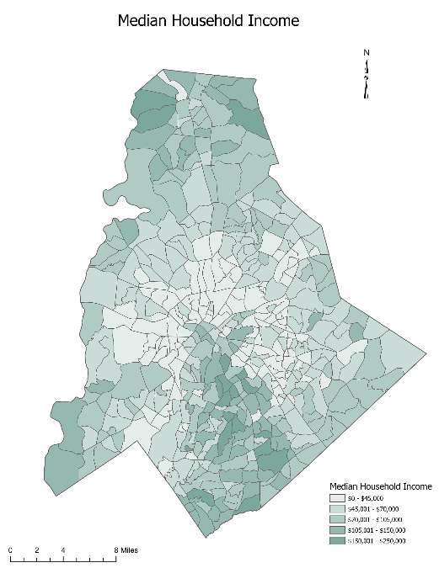
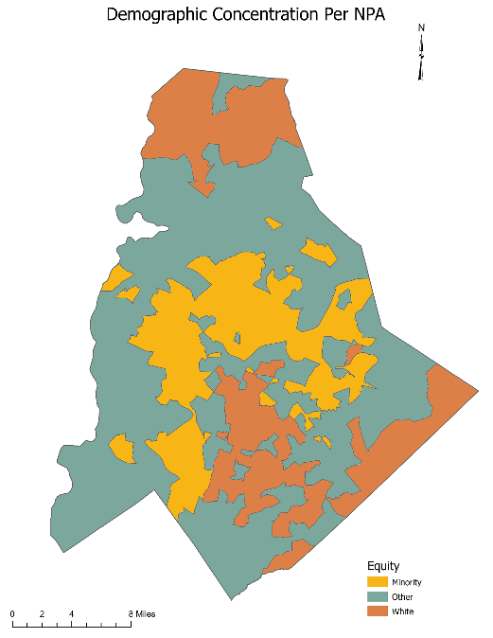
Racial Equity as Spatial Equity
Data & Methodology
Lines of Segregation
Historical inequities such as redlining and institutional racism continue to leave their impression in how Charlotte is spatially constituted. Maps of White and Black population concentrations reveal a clear definition to the contours of segregation. Equally informative is the map of household income that shows the wealth concentration in areas with significant White population percentages. The base geographic unit used for these measurements in the maps is a ‘neighborhood profile area (NPA) – a commonly used unit for local quality of life and social outcome measurement.
The equity focus on Charlotte will be incomplete without articulating racial equity as a spatial equity problem as well. To this end, two areas have been defined as a basis for spatial measurement of the equity indicators.
1) Predominantly White Areas (PWA): Any NPA with 80% or more of White residents in its total population.
2) Minority Concentrated Area (MCA): Any NPA with a 70% or more non-White residents in its total population.

Slide 8
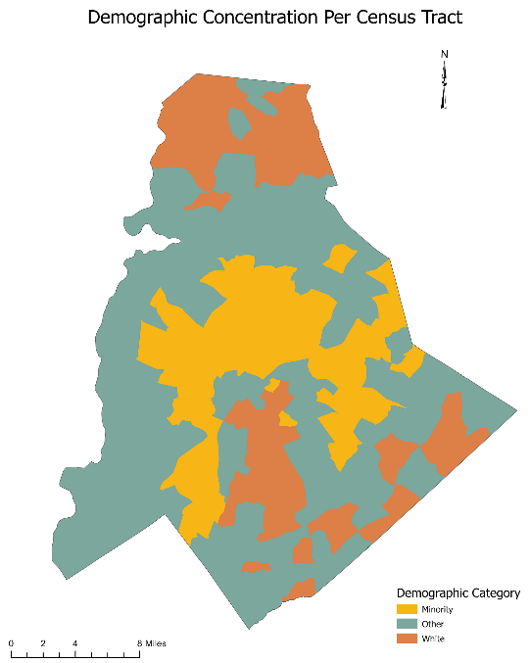
Measuring Spatial Equity
Data & Methodology
‘The Wedge’ and ‘the Crescent’
Following the definitions for PWA and MCA, both NPAs and Census Tracts were aggregated to create areas as shown in the maps.
The definitions largely mirror the stereotypical ‘Wedge’ and ‘Crescent’ terminology used in local policy circles that denote the largely white resource-rich area in South-South-West Charlotte and the surrounding minority, poorer areas. While the ‘Crescent’ is traditionally understood as ‘everything except the Wedge’, the Crescent used to generate equity indicators eliminates many transitional, mixed suburban neighborhoods focusing on the poles of disparity.
PWA and NPA definitions are made at both Census Tract and NPA levels to analyze variables available in their respective resolutions.

Slide 9
Measuring Equity
Data & Methodology
Data
Data used in this report is drawn from the American Community Survey (public use microsample 1-year estimates, 5-year estimates), and from state and local agencies. Spatial data at neighborhood level (NPA) comes from Mecklenburg County open data portal and the quality of explorer – a collaborative project between the City of Charlotte and Urban Institute.
Measuring Equity
The report uses the equity score measure developed by the CUNY ISLG that has been adopted for Equity Indicator projects in Oakland, St. Louis, Dallas and other cities.
The equity score provides a simple, standardized measure ranging from 100 (indicating no disparity) to 0 (extreme disparity) that allows comparing equity measures generated from diverse data sources. The scores correspond to the ratio of an indicator’s measurement between groups as given in the chart.
For example, say Black households have a median household income of $50,000 and White households’ median income is $80,000. The ratio between them is 1.6 indicating that White households income is 1.6 times that of Black households. This value falls between a set of upper and lower-bound values in the equity score chart that corresponds to the score. When the ratio is 1, the equity score is 100.

Slide 10
Analytical Strategy
Data & Methodology
Choice of Indicators
The indicators are chosen through stakeholder engagement, previous local research on variables related to quality of life in Charlotte, and research about similar efforts undertaken in other cities.
Analytical Strategy
Household and Individual level data
Individual and household raw data from American Community Survey public use microsample for years 2019, 2018, 2017 and 2016 were collected. The raw data for North Carolina in which the PUMA areas for Mecklenburg county were identified for disaggregate analyses. Persons Table and Households table were used with their respective replicate weights to generate descriptive statistics and standard errors for the indicator variables.
Race of the Household
Poverty Thresholds
Spatial / Aggregate Data
Base spatial data and demographics were collected from ACS-5 year estimates and the quality of life explorer data to perform aggregate analyses on the neighborhood level.

Slide 11
Financial Health and Economy

Slide 12
Median Personal Income
Indicator #2
Equity Score : 59 White-to-Black Ratio: 1.53 Median Annual Income in White working adults was 1.53 times that of Black working adults in 2019
What is measured?
Median annual incomes for currently employed White and Black adults aged 25-64 working 30+ hours per week.
Why is this important?
Personal income represent one of the key markers of economic well-being and related to a large set of social and economic outcomes such as poverty, unemployment and quality of life.
Findings
Median Personal Income for White working adults was $60,608 while for Black working adult was $40,405. Compared to 2018, the 2019 disparity as indicated by the score is slightly lower but the previous years' equity scores show that income inequity at the individual level has remained largely the same.
Data Source(s): American Community Survey Public Use Microsample 1-year Estimates

Slide 13
75th Percentile Personal Income
Indicator #2
Equity Score : 43 White-to-Black Ratio: 1.93 75th percentile incomes of White working adults are almost twice that of Black adults.
What is measured?
75th percentile annual incomes for currently employed White and Black adults aged 25-64 working 30+ hours per week.
Why is this important?
Median income captures the midpoint of income level but is insufficient to understand if the income disparities vary across the distribution. The 75th percentile shows the change in equity at higher income levels as well as proxies for economic opportunities in the form of high-wage occupations.
Findings
The equity levels worsen at the 75th percentile level. White working adults had a 75th percentile annual income of $1,07,075 while Black working adults were at $55,558. This disparity has been steadily worsening since 2017 as shown by equity score having dropped from 51 to 43 in 2019. The indicator shows that higher-wage occupations and higher economic growth may be flowing disproportionately towards White population.
Data Source(s): American Community Survey Public Use Microsample 1-year Estimates

Slide 14
Median Household Income
Indicator #1
Equity Score : 48 White-to-Black ratio: 1.81 Median Income in White households were 1.8 times that of Black households in 2019
What is measured?
Median annual income of White and Black households
Why is this important?
Similar to personal income, median household income is a prime marker of economic well-being of families and communities. Household income is also an important public policy tool to determine eligibility for subsidies and other public welfare programs.
Findings
Equity score of 48 indicates that disparities between White and Black households are greater compared to persons (personal income chart). White households had a median annual income of $87,883 while Black households were are 48,446 in 2019. This large disparity is a new low in the worsening equity levels since 2016 as indicated by the scores since then.
Data Source(s): American Community Survey Public Use Microsample 1-year Estimates

Slide 15
75th Percentile Household Income
Indicator #2
Equity Score : 44 White-to-Black ratio: 1.90 White households at 75th percentile made about $72,000 more than Black households in 2019
What is measured?
75th percentile income estimates of White and Black households in Mecklenburg County
Why is this important?
Similar to 75th percentile personal income, this measure analyzes the change in the disparities at higher income groups within each race.
Findings
75th percentile income for White Households was $1,51,521 while for Black households this was $79,700. The stark income inequality between White and Black population has been rising since 2016 as indicated by progressively lower equity scores. Also, consistent with the pattern in personal income, equity scores are worse compared to the median income levels.
Data Source(s): American Community Survey Public Use Microsample 1-year Estimates

Slide 16
Poverty

Slide 17
Household Poverty Rate
Indicator #2
Equity Score : 40 Black-to-White Ratio: 2.12 Black households are more than twice as likely to be in poverty as White households
What is measured?
The percentage of the Black and White households living at or below the federal poverty level, as defined by the U.S. Department of Health and Human Services. (Source: https://aspe.hhs.gov/poverty-guidelines)
Why is this important?
Families living in poverty represent the level of economic struggle of communities to meet basic necessities of life and a pointer to the resource imbalance between demographic groups. Given Charlotte’s low ranking in intergenerational economic mobility among cities, the poverty rate illustrates the disparity in economic well-being across racial lines
Findings
Results suggest that Black households are more than twice as likely to be in poverty as White households. In 2019, 11.44% of Black households were in poverty compared to 5.39% of White households. The level of disparity has been increasing over the recent years as shown by worsening equity scores since 2016.
Data Source(s): American Community Survey Public Use Microsample 1-year Estimates

Slide 18
Child Poverty

Slide 19
Child Poverty Rate
Indicator #2
Equity Score : 35 Black-to-White Ratio: 2.88 Children in Black households are almost three times as likely to live in poverty than Children in White households
What is measured?
Percentage of Black and White households with children (<17 years) below federal poverty threshold.
Why is this important?
The more insidious version of poverty when children grow up in poverty that exclude them from economic opportunities, safety, quality education and general quality of life. The racial disparity in the socio-economic status on sustaining intergenerational wealth disparity is well documented.
Findings
11.3% of Black households with children were in poverty compared to 3.92% of White households. The absolute child poverty rate in Black households has decreased since 2017 (17.2%) but the disparity has worsened as indicated by lower equity scores in recent years.
Data Source(s): American Community Survey Public Use Microsample 1-year Estimates

Slide 20
Child Food Insecurity
Indicator #2
Equity Score : 22 Black-to-White Ratio: 4.48 Children in black households are about 4.5 times more likely to be food insecure than those in White households
What is measured?
Percentage of Black and White households with children under 18 that received SNAP(supplemental nutritional assistance program) benefits in the past 12 months.
Why is this important?
SNAP, formerly known as the Food Stamp Program, helps low-income individuals and families afford food. While SNAP is an important federal anti-hunger program, recipiency of SNAP benefits suggests that households are experiencing problems with food security and access
Findings
23.47% of Black households with children were food insecure compared 4.86% of White households in 2019. This stark disparity is worsening since 2016 as indicated by the low equity scores. The absolute percentages of Black households and White households on this measure has decreased since 2016 but the disparity persists and is widening.
Data Source(s): American Community Survey Public Use Microsample 1-year Estimates

Slide 21
Housing & Mobility

Slide 22
Home Ownership
Indicator #2
Equity Score : 57 White-to-Black Ratio: 1.58 66 % of White households were owned compared to 42% of Black households
What is measured?
Percentage of households that are owned with or without mortgage
Why is this important?
Findings
The equity score of 57 corresponds to the fact that White households are 1.5 times more likely to be owned than Black households. Compared to 2016 when the Black home ownership percentage was 38.2%, 2019 has seen improvement to 42.1% while White home ownership percentages across these years have been stable at around 66.5%. This is reflected in the improved equity scores.
Data Source(s): American Community Survey Public Use Microsample 1-year Estimates

Slide 23

Home Ownership (Spatial)
Indicator #2
Equity Score : 40 White-to-Black Ratio: 2.02 Households in predominantly White areas were twice as likely to be owned compared to minority concentrated areas.
What is measured?
Percentage of owned households in each NPA aggregated to PWA and MCA
Why is this important?
Findings
78.2% of households in PWA were owned compared to 39.7% in MCA in 2018. The equity score of 40 is significantly lower than the score on home ownership between White and Black households, indicating that the spatial inequities on home ownership amplify the disparities between demographic communities in Charlotte.
Data Source(s): American Community Survey Public Use Microsample 1-year Estimates

Slide 24
Rent Burden
Indicator #2
Equity Score : 70 Black-to-White Ratio: 1.30 54% of Black households were rent-burdened compared to 41% of White households
What is measured?
Percentage of households that spent 30% or more of their income on rent.
Why is this important?
Findings
Equity score of 70 corresponds to the fact that Black households are 1.3 times more likely than White households to be rent-burdened in 2019. The equity scores have remained the same since 2016 indicating no improvement in equity in the recent years.
Data Source(s): American Community Survey Public Use Microsample 1-year Estimates

Slide 25
Rent Burden (Spatial)
Indicator #2
Equity Score : 63 PWA-to-MCA Ratio: 1.44 Minority neighborhoods are 1.44 times more likely to be rent burdened than White neighborhoods
What is measured?
Percentage of Rent burdened (Households spending >30% of their income on rent) households in each NPA aggregated to PWA and MCA.
Why is this important?
Findings
The significant disparity in rent burden across space suggests that housing vulnerability and associated employment vulnerability due to high rent burden disproportionately affects minority neighborhoods.
Data Source(s): American Community Survey Public Use Microsample 1-year Estimates

Slide 26
Travel Time to Work
Indicator #2
Equity Score : 100 White-to-Black Ratio: 1 Travel times to work are largely balanced between White and Black populations.
What is measured?
Average time spent commuting one way to work (in minutes) for Black and White adults aged 25-64.
Why is this important?
Travel time to work impacts job opportunities, housing choice, transportation access and costs and work-life balance.
Findings
Median income estimates of White and Black households in Mecklenburg County
Data Source(s): American Community Survey Public Use Microsample 1-year Estimates

Slide 27
Business and Employment

Slide 28
Business Ownership
Indicator #2
Equity Score : 56 White-to-Black Ratio: 1.6 White adults are 1.6 times more likely to own a business than Black adults.
What is measured?
percentages of Black and White adults aged 25-64 who are self-employed
Why is this important?
Findings
5.95% of Black adults owned a business in 2019 compared 9.52% of White adults. The equity score of 56 represents an improvement from previous years when the ratio was around 2-2.3 times compared to 1.6 in 2019. But the disparity level in absolute terms is significant.
Data Source(s): American Community Survey Public Use Microsample 1-year Estimates

Slide 29
Labor Force Non Participation
Indicator #2
Equity Score : 90 White-to-Black Ratio: 1.05 Disparities in labor force non-participation are lower compared to other indicators
What is measured?
percentages of Black and White adults aged 25-64 who are not in the labor force.
Why is this important?
Findings
15.47% of White adults were not in labor force compared to 14.72% of Black adults in 2019. These levels have been largely similar since 2016 as indicated by the high equity scores. The economic disparity in income and poverty outcome persists despite the fact that adults from both races are engaged equally in the labor force.
Data Source(s): American Community Survey Public Use Microsample 1-year Estimates

Slide 30
Public Health

Slide 31
Health Insurance Non-Coverage
Indicator #2
Equity Score : 70 White-to-Black Ratio: 1.30 Black individuals are 1.30 times more likely to lack health insurance than White individuals.
What is measured?
Percentage of individuals within White and Black population who lacked health insurance coverage
Why is this important?
Findings
11.89% of Black individuals lacked health insurance in 2019 compared to 9.1%. The equity score of 70 has remained largely stable since 2016.
Data Source(s): American Community Survey Public Use Microsample 1-year Estimates

Slide 32
Life Expectancy (Spatial)
Indicator #2
Equity Score : 75 PWA-to-MCA Ratio: 1.21 A person in a minority neighborhood lives about 13 years lesser than one in a White neighborhood
What is measured?
Average age of death in a NPA aggregated to PWA and MCA
Why is this important?
Findings
The average age of death in PWA is 76 and MCA is 63. The disparity, as indicated by the equity scores, has persisted across years. The statistics illustrate the significant differences in public health and quality of life outcomes despite sharing a common urban area and services.
Data Source(s): Mecklenburg County Health Department

Slide 33
Pre-Natal Care (Spatial)
Indicator #2
Equity Score : 60 PWA-to-MCA ratio: 1.52 Mothers in PWA are 1.5 times as likely to receive pre-natal care as the ones in minority neighborhoods.
What is measured?
Percentage of births where mother received adequate pre-natal care in each NPA aggregated to PWA and MCA
Why is this important?
Access to prenatal care is impacted by health insurance coverage, accessibility of affordable health care providers, transportation and child care, cultural or language barriers, and availability of education and outreach programs. Inequities in these factors may lead to differential outcome on this indicator.
Findings
78.4% of births received pre-natal care in PWA while only 51.6% in MCA received the same in 2016. The pattern of this disparity is also persistent across time as indicated by similar equity scores.
Data Source(s): Mecklenburg County Health Department

Slide 34
Education

Slide 35
High School graduation
Indicator #2
Equity Score : 78 PWA-to-MCA Ratio: 78 Minority neighborhoods see, on average, a 12% lower high school graduation rate compared to PWA
What is measured?
Median income estimates of White and Black households in Mecklenburg County
Why is this important?
High school graduates have more opportunities for continued education, higher lifelong earnings, and better health outcomes, and communities with more-educated residents have greater productivity and economic growth.
Findings
96.5% of high school students graduated in predominantly white neighborhoods in 2017 compared to 84.6% in minority concentrated neighborhoods. The disparity, as seen from the equity score, has been seeing a marginal improvement since 2014
Data Source(s): Charlotte-Mecklenburg Schools

Slide 36
Educational Attainment
Indicator #2
Equity Score : 50 White-to-Black Ratio: 1.75 Significantly lower percentage of Black adults have a bachelor’s degree (or higher).
What is measured?
Percentages of Black and White adults aged 25-64 with a bachelor's degree or higher
Why is this important?
Findings
59.76% of White adults had a Bachelor’s degree of higher compared to 34.09% of Black adults in 2019. The disparity while significant continues to be stable since 2016 as indicated by similar equity scores. However,in 2019 both racial groups have larger proportion of adults with this level of education compared to 2016 indicating that the improvement has been largely balanced.
Data Source(s): American Community Survey Public Use Microsample 1-year Estimates

Slide 37
Civic Engagement

Slide 38
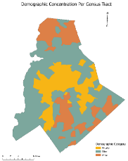
Voter Participation (Spatial)
Indicator #2
Equity Score : 84 White neighborhoods see a 1.33 times higher voter participation than MCAs.
What is measured?
Percentage of registered voters that voted in the general election
Why is this important?
Voter participation represents political voice and a key contributor to reforms and political action.
Findings
Voter participation in PWAs was about 81% compared to MCAs with 60%. This is slightly improved from 2016 general elections as indicated by the equity scores.
Data Source(s): American Community Survey Public Use Microsample 1-year Estimates

Slide 39
In the anvil..

Slide 40
In the works.. (or should be in the works)
Indicator #2
More ACS Variables – Use PUMS effectively
More QoL Data
Public Health Data
CMPD Data
Better School Data
Income Dimensions
Hispanic and Asian Groups’ Statistics
MCA or Black dominant areas?
Improve the code to generalize to other areas in the region and easily update reporting.

